Slide 1
Information Technology Investment: Decision Making Methodology
Chapter 3
Measuring Information Technology Performance

Slide 2
Prologue
Investments in IT have to be justified,
or else organizations would not invest in IT
Conventional IT Metrics
: Availability, Response Time, Throughput,…
Suggested IT Metrics
: Profit, Cost, Customer Experience,…
Expressed as Perceived Values

Slide 3
I. Introduction
To evaluate an investment it must be measured in some way for comparison
This chapter is focused on introducing a variety of measures for the evaluation of IT investments

Slide 4
II. The Economics of Information
Economics of Information
: a systematic series of concepts and theories that explain the role which information and IT play to assist an organization
The economics of information presents rules with which to assess the expected and actual impact of investing in a particular IT
Hard to find out single rule to actually assist every IT evaluation

Slide 5
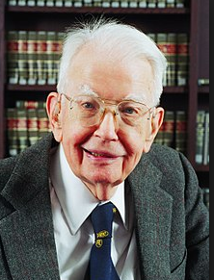
II. Examples of the Economics of Information
Transaction cost theory (Coase’s Law)
: To economize on transaction(internal & external) costs
: Explains the origin of firms
B
b
Transaction costs (External )
Transaction
cost reduction
occurs due to IT investment
A
C
c
a
Size of
the firm

Slide 6
II. Examples of the Economics of Information
Agency cost (Internal Trans. Cost)
Agency
cost reduction
occurs due to IT investment
Agency theory I
: As firms grow in size, the owners have to increase its employees who act as agents.
: By investing in IT, less agents are required to manage the firm.
B
b
A
C
c
a
Size of
the firm
A reduction in the agency costs from B to b, reduces the size of the firm from a to c

Slide 7
II. Examples of the Economics of Information
Transaction cost theory + Agency theory
Digital economy tends to expedite downsizing of the firms
Unemployment Crisis !!!
Apple vs. Samsung
Total Trans. costs
Size of the firm
(Outsourcing vs. Insourcing)

Slide 8
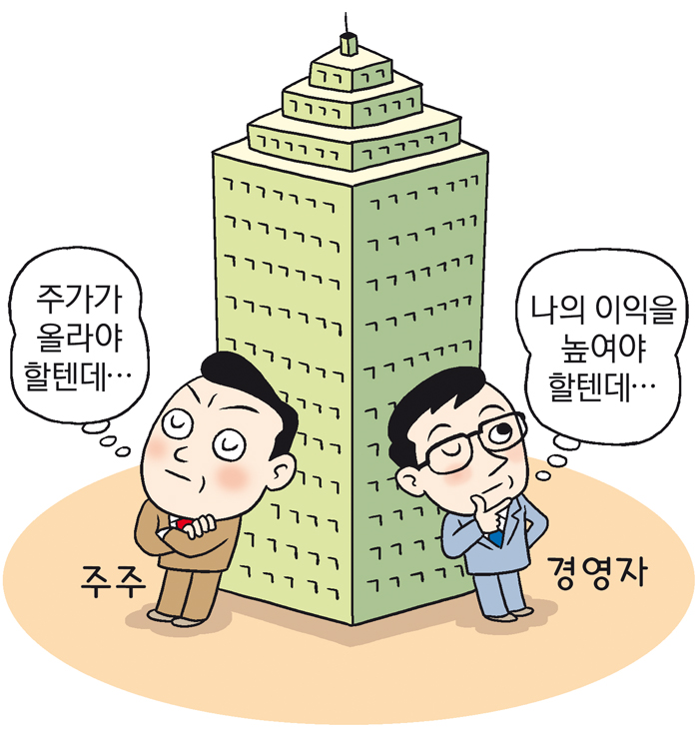
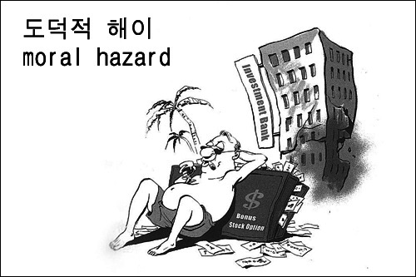
II. Examples of the Economics of Information
Agency theory II
Principal is too busy to do a given job and so hires the Agent.
Being too busy also means that the Principal cannot monitor the Agent perfectly.
There are a number of ways that the Principal might then try to motivate the Agent: incentive contracts (similar to profit sharing or sharecropping), timing, payoff, and so on.
By investing in IT, these could be resolved !!!

Slide 9
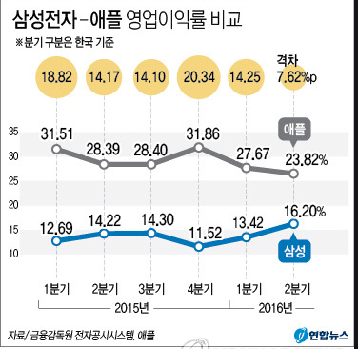
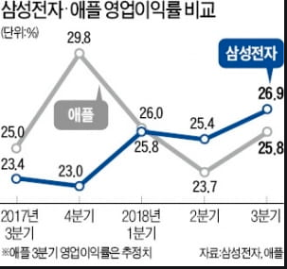
II. Examples of the Economics of Information
Economies of scale
Production : Technology of production is increasingly cost-effective as the scale grows
Information : Information is not consumed by use, and can be used cost-effectively for larger scale of operation
Network externalities : It becomes dominant as it increases market share or geographical scope
30.9
The size of a firm
Vertical Size : Range of value chain which the firm spans using its own hierarchy
Horizontal Size : Number and share of markets in which firm sells its goods and services
Samsung vs. Apple : Who will be a winner? Who will be the most (transaction and agent) cost-efficient ?
30.0
24.6
19.7
12.1
18.5
2019
2020
2021

Slide 10
II. Examples of the Economics of Information
Roles of Information Systems in Organization
Operation : IT increases scale and scope efficiencies of the firm’s operation
Transaction Processing : IT processes basic business transactions
Monitoring/Performance: IT monitors, records, and evaluates performance of employees and their functions
Documentation/Communication: IT maintains records of status and change in the fundamental business functions within the organization
Decision Support: IT collects and provides information relevant to managerial decisions
IT can lead to more centralized management, more decentralized divisions, therefore,
hybrid organizational structures
However, net effect may vary case by case !!!

Slide 11
III. Why Measure IT Performance?
ANSWER: Simply, to evaluate the functioning of an IT investment. To assess the business value, the efficiency, and effectiveness of an IT
No Improvement Without Measurement
Other reasons…
To fully understand the impact of IT investment
To evaluate and prioritize different IT projects
To improve communication between executives and IT
To learn valuable experience
…

Slide 12
IV. Measures of IT Business Value
Business value of IT : Overall value of IT on the bottom line performance of an organization
IT investments contribute to overall org. performance by improving
-financial performance
-business performance, and/or
-strategic performance

Slide 13
IV. Measures of IT Business Value
The first step to determine business value of IT is to identify the objectives of IT investments
The next step is to select at least one measure to assess each objective.
There are many measures to choose from and more than one is better.

Slide 14



V. Financial Performance Measures of IT
Ratios | Calculation | Explanation
Profitability measures
Return on equity |  | Measures profitability of the investment to the owners
Return on assets |  | Measures profitability and how efficiently assets were utilized
Return on investment |  | Measure profitability based on total investment, both debt and equity

Slide 15



V. Financial Performance Measures of IT
Ratios | Calculation | Explanation
Profitability measures
Return on sales |  | Measures profitability based on sales
Earnings per share |  | Measures earnings per share value
Revenue growth |  | Measures growth in revenue over the prior period

Slide 16

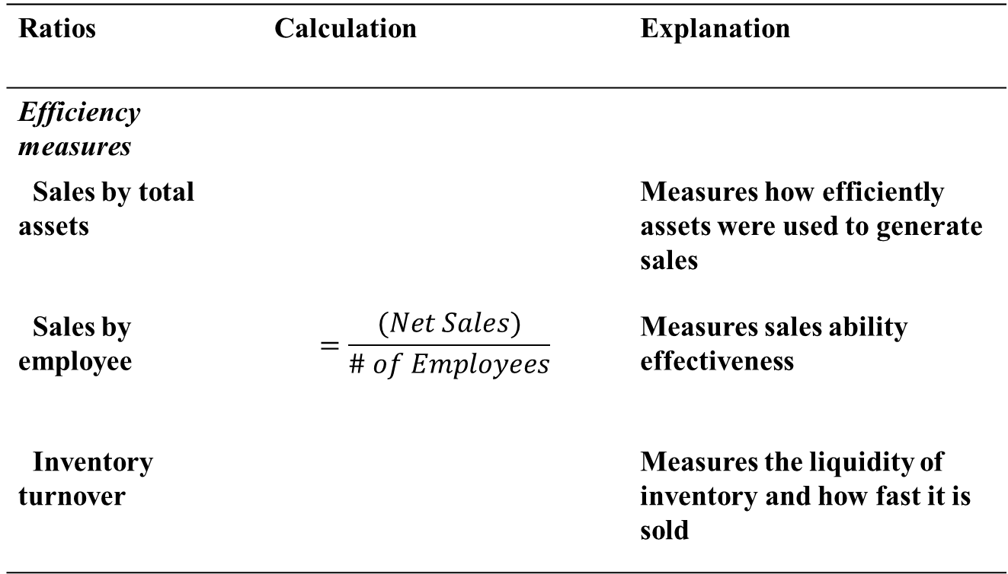
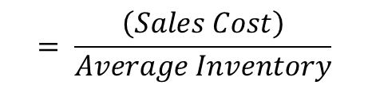
V. Financial Performance Measures of IT
Ratios | Calculation | Explanation
Efficiency measures
Sales by total assets |  | Measures how efficiently assets were used to generate sales
Sales by employee | $$=\frac{(Net Sales)}{\# of Employees}$$ | Measures sales ability effectiveness
Inventory turnover |  | Measures the liquidity of inventory and how fast it is sold
$$= \frac{\left(Sales Cost\right)}{Average Inventory}$$

Slide 17
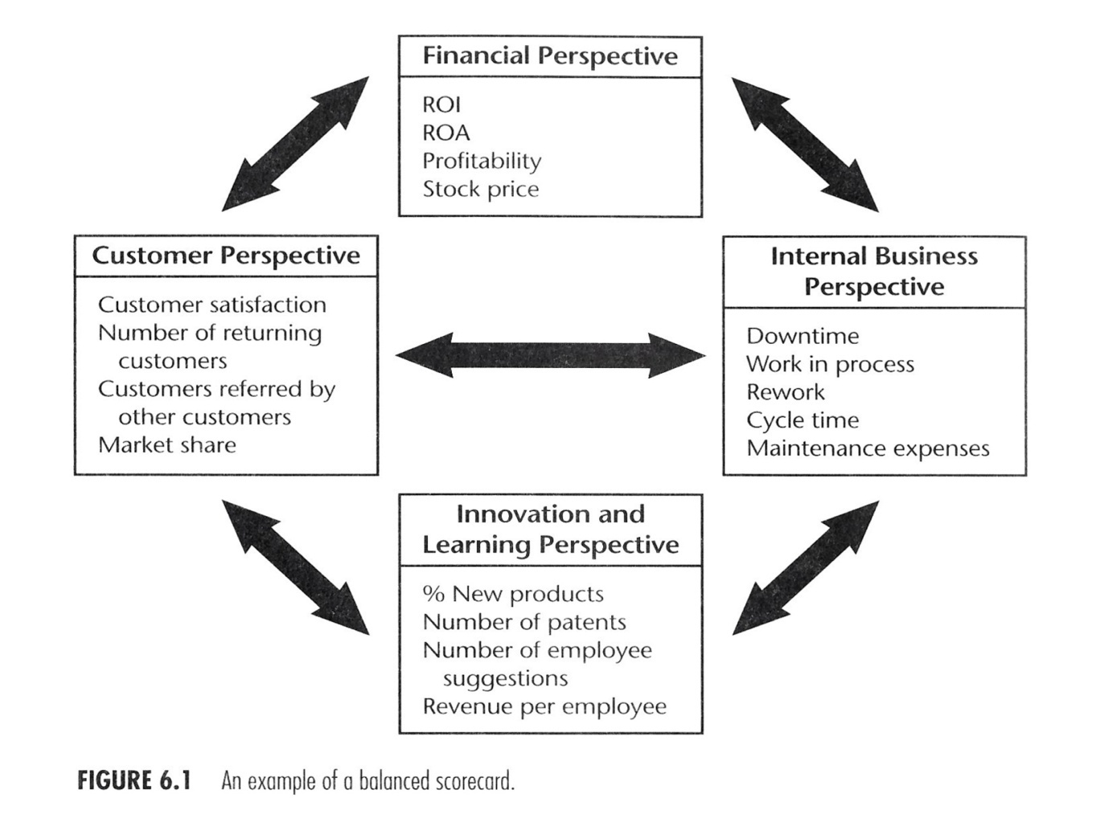
V. Biz performance measures
Balanced Score Card (BSC, Kaplan&Norton)

Slide 18
V. Biz performance measures
Balanced Score Card (BSC)
Financial (ROI, EPS,..)
Operational (CS, Internal process, Innovation & Learning activities)
Future Financial performance
BSC
Helps mgr. view performance simultaneously
Makes mgr. focus on critical measures
Force mgr. to consider all the important operational measures
Allows mgr. to view their biz from four perspectives
(Financial, Customer, Internal, Innovation & Learning)

Slide 19
V. Biz performance measures
Financial Perspective
A key factor for a company’s worth
Ability to translate operational performance to improved financial performance
Better operating margin
Should learn to make explicit linkages between operations and finance

Slide 20
V. Biz performance measures
Customer Perspective
Critical to a biz survival
Time, Quality, Performance & Service, Cost
Greater consequences in new technology implementation
Perceived ease-of-use & Perceived usefulness
Key to User Acceptance

Slide 21
V. Biz performance measures
Internal Biz Perspective
To stay on top of the competition or To satisfy customer needs
Gives mgr. an opportunity to focus on the internal operations enabling the above
While host of metrics are tracked, very little is used to assess past and present directions, strategies, and goals for the future

Slide 22
V. Biz performance measures
Innovation & Learning Perspective
To prepare for the changing landscape of Biz
Continuous improvement & Introducing new products and services at the same time
Innovation : ability to develop & introduce new product rapidly
Learning : ability to continuously improve the existing processes

Slide 23
V. Biz performance measures
Final thoughts on BSC
Providing a dashboard of metrics, BSC helps mgr. understand interrelationships between the four perspectives
Broader outlook helps mgr. view the org. as a whole and what works best for it
See Table 2~5

Slide 24
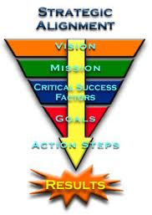
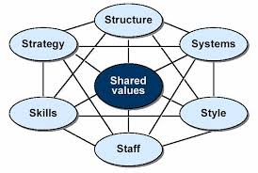
V. Strategic performance measures
CSF(Critical Success Factors)
A few key areas that the org. must excel at to survive and thrive

Slide 25
Seoultech Examples of CSF
Critical Success Factors
Key Performance Indicators

Slide 26
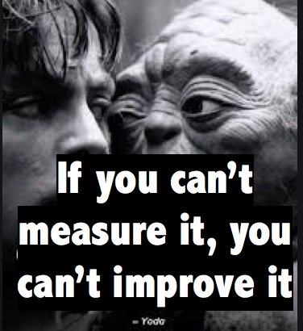
Seoultech Examples of CSF

Slide 27
VI. Costs of IT
Cost Categorizations for IT
Costs by Activity | Costs by Resource
1. Development costs | 1. Technology costs
2. Maintenance costs | 2. Personnel costs
3. Operating costs | 3. Outside services costs
4. User support costs | 4. Other costs
5. Administration and other costs

Slide 28
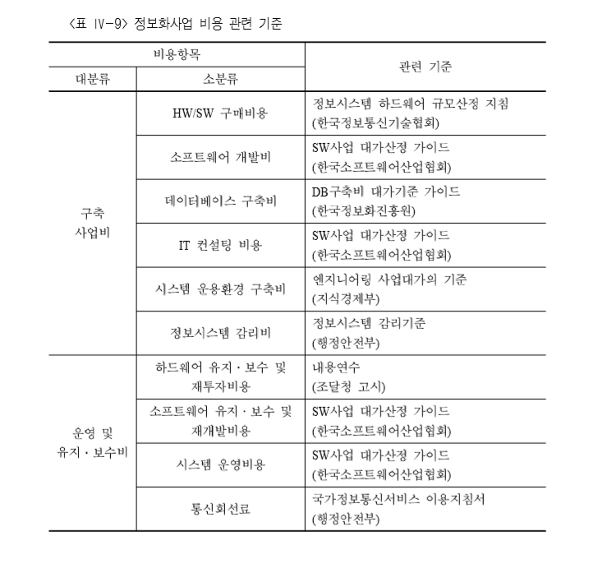
A Guidebook for PFA (KDI, 2013)

Slide 29
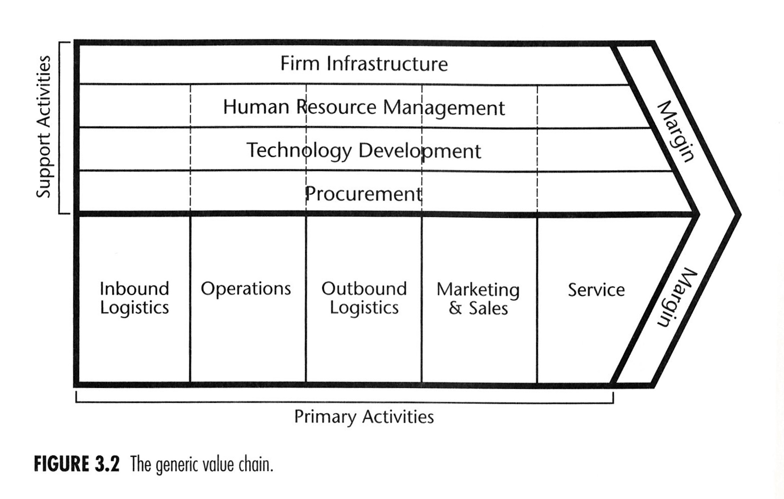
VII. Measures of IT Effectiveness Value
Effectiveness = “Doing the right things (Innovation)”
Efficiency = “Doing the things right (Standardization)”
Deliver the right products and services, with the right features, to the right customers, at the right time

Slide 30
VII. Measures of IT Effectiveness Value
How to access Effectiveness factors
To identify the biz. process supported by IT(Porter’s VCM)
To identify the different categories of IT(Table 7)
To create a process/IT matrix of biz. Process(Fig. 3)
To access an effectiveness factor(Table 8)
Effectiveness Factors(Table 9) → criteria → measures
Identify IT factors
Define effectiveness criteria for all the factors
Develop measures for the criteria
Measuring the IT Effectiveness examples
To support biz. Processes (Table 8)
To support employees (Table 10)
To meet biz. requirements (Table 11, 12)

Slide 31
VIII. Measures of IT Efficiency Value
Efficiency = “Doing the things right”
Produce the desired effect with minimum IT expenses
Effectiveness first, then efficiency follows.
See Table 13

Slide 32
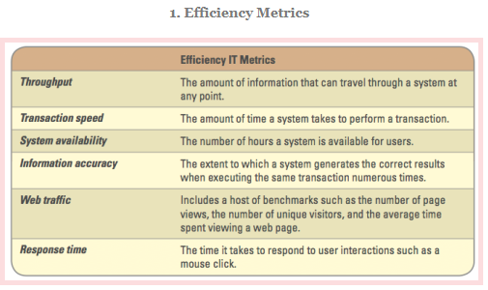
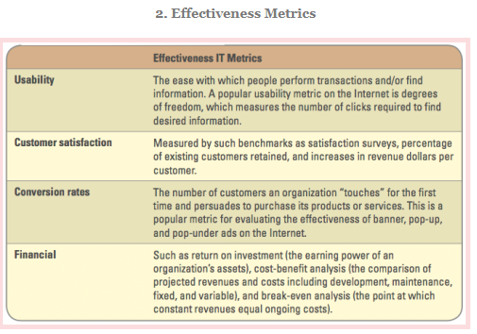
IT Efficiency and Effectiveness Measures
Efficiency focuses on the extent to
which an organization is using its
resources in an optimal way
Effectiveness focuses on how well an organization is achieving its goals and objectives

Slide 33
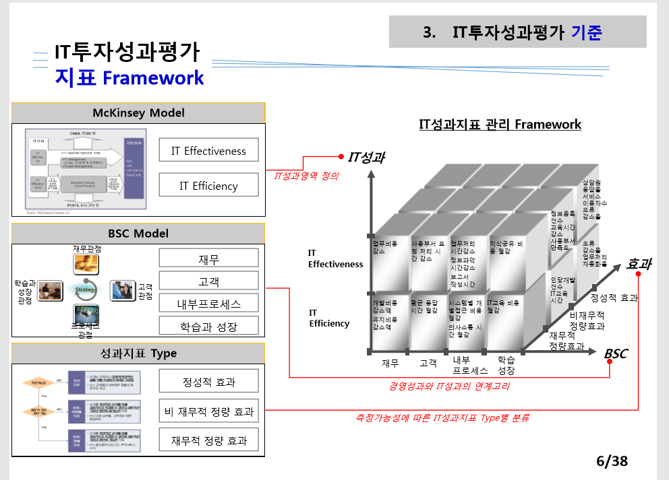
Bank of Korea IT Performance Metrics

